Slide 1

SMART FARMING SYSTEM

Slide 2


TEAM MEMBERS
Stephanie Perea
Sandia National Laboratories Retiree
Full-time Student

Slide 3
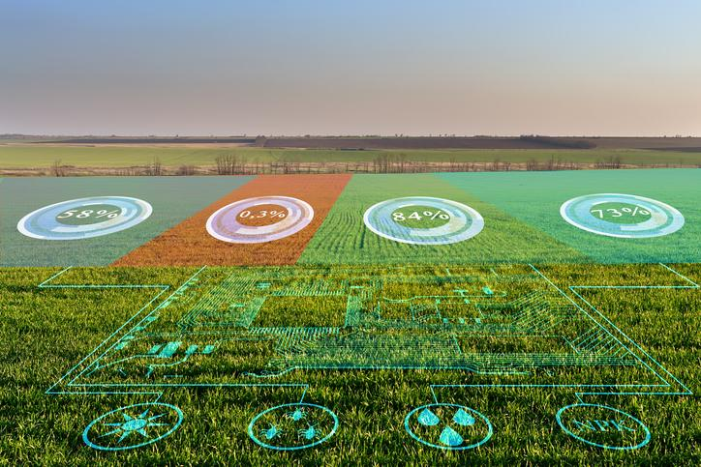
What is a Smart Farming System (SFS)
An SFS provides an array of
resources for real-time
environmental stats
& physical security

Slide 4
The Purpose and Background
The purpose of this project came about from my real-life experiences
Hemp legalization occurred under the 2019 Farm Bill in 2018
USDA as not able to provide guidance to assist farmers until March 22, 2021.

Slide 5
The Problems
Problem #1 - Pest Control
A lack of pest control guidance impacted the first 2 grow seasons
Caused many hemp crops to fail because of pest infestation
Many farms going organic
Pesticide problem is still needing to be addressed
Problem #2 - Security
Theft causes loss in yield
Creates legal issues for farmers due to licensing requirements
Legal responsibility to maintain control of all hemp produced.

Slide 6
The Problems Cont..
Problem #3 - Pollination
Pollination triggers seed propagation
Decreases trichome production
Trichomes are the mechanism by which hemp produces cannabinoids, such as cannabidiol (CBD)
Majority of New Mexican farmers invested in high CBD hemp strains to produce, manufacture and sell high quality CBD hemp oil not seed generation
Problem #4 - weather
Dry and hot summer days led to improper soil moisture management
Caused many hemp plants to fall into a stressed state
A stressed state causes a spike in tetrahydrocannabinol (THC) production
Caused hemp to surpass the 0.3% THC legal threshold
Led to the destruction of many New Mexico hemp crops.
Notes:
Excess moisture also forms
Fungus
Mold
Macro-organisms
Hemp biomass rendering it useless for oil production

Slide 7
The Smart Farming Systems’ functions and solutions

Slide 8
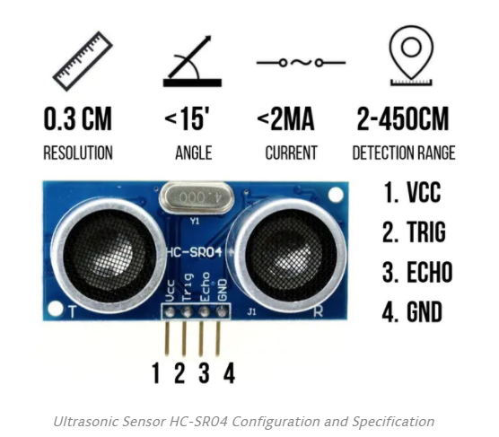
Pest Control
Environmentally Friendly
Wireless
WiFi
Prototype Pulse output up to 26 feet away
Cloud Computing
Cost Effective

Slide 9
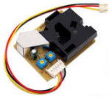
Pollen Monitoring
Grove Particulate Sensor
Capable of detecting particles as small as 1 um in size
Hemp pollen measures approximately 25 um and thus is not difficult to detect.
Monitors pollen for optimal trichome and cannabinoid yield
Pollination control to prevent seed propagation
Note: Majority of seed planted in New Mexico was/is feminized and guaranteed to produce approximately 97% female plants per pound. This sometimes triggers female plants to morph into hermaphrodites to secure future generations.
Notes:
The pollination season begins about 4 to 5 weeks after females’ flower which will be read by the Pollination Monitoring System

Slide 10
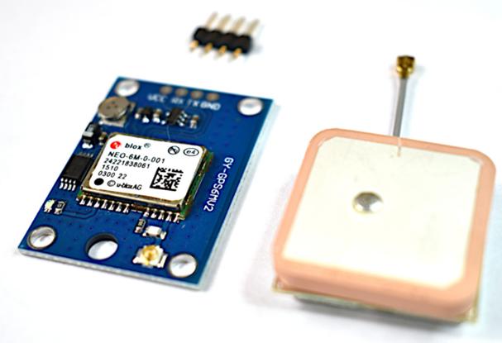
The Smart Farming System also houses a NEO-6M GPS Module to assist in locating pollen generators in the crop
Module Description:
Power Supply: 3V-5V
EEPROM
LED Indicator
Backup battery
Baud Rate: 9600
Module Dimensions: 23mm x 30mm
Antenna Dimensions: 25mm x 25mm
Antenna Cable Length: 50mm
Arduino UART Compatible

Slide 11
Security System
Reduces Carbon Footprint
Prototype Pulse Return
Distance 13 feet
Maximum direct line sight
Real-time Text Notification when system detects intruder

Slide 12
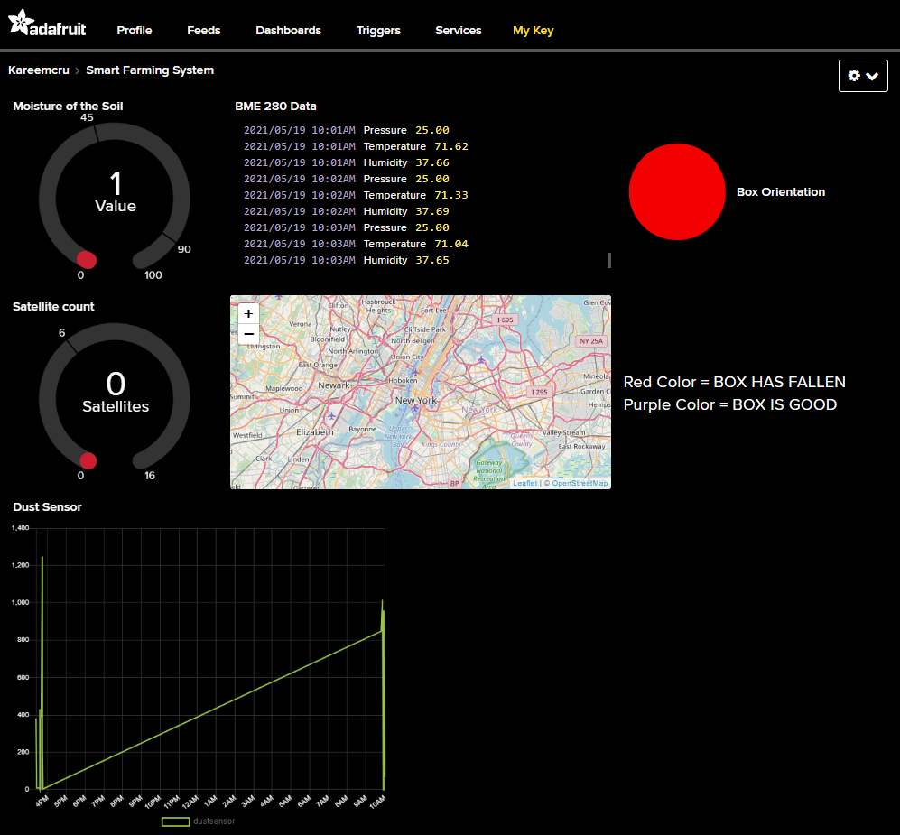
The Smart Farming System houses its own weather station The system is equipped with a monochrome display for real time weather data out in the field. Data can also be accessed from anywhere in the world via Adafruit.io cloud computing.

Slide 13
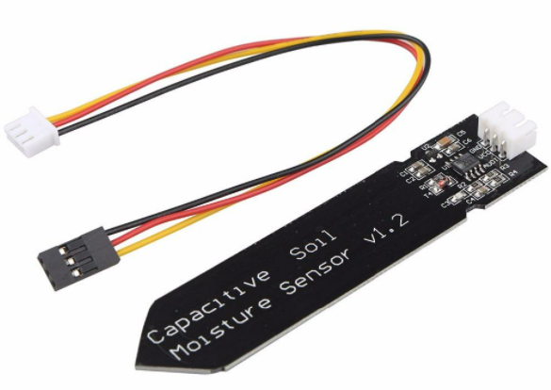
Weather Station The Smart Farming System utilizes a soil sensor to monitor moisture levels using capacitance rather than resistance to determine the water content of soil. The module uses a TL555I CMOS timer to create a 1.5MHz clock A peak voltage detector converts the waveform from the TL555I into a DC voltage that can be read by the ADC input of a microcontroller. When the probe is exposed to moisture, it affects the capacitance of the circuit which in turn affects the peak amplitude of the signal and therefore the DC voltage output that is being monitored by the MCU. Higher moisture = lower DC voltage output.

Slide 14
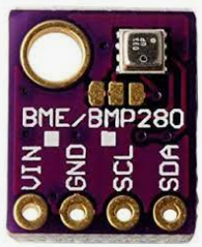
The BME280 Component can measure:
Relative humidity from 0 to 100% with ±3% accuracy
Barometric pressure from 300Pa to 1100 hPa with ±1 hPa absolute accuracy
Temperature from -40°C to 85°C with ±1.0°C accuracy.
Note: The pressure measurements are so precise (low altitude noise of 0.25m), can be used as an altimeter with ±1 meter accuracy.

Slide 15
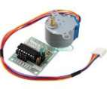
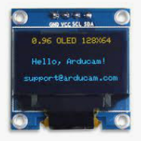
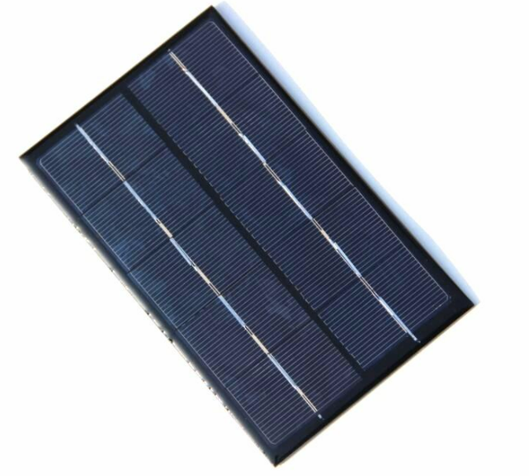
Side Components
Solar Cell
1X 6V 1W 110x60mm Micro Mini Power Small Polycrystalline Panel Module
Stepper Motor
5VDC
Class B insulation
Internal wiring to sustain temperatures of up to 130 degrees Celsius
OLED Display
Interface： I2C
Number of Pixels：128 x 64
Color Depth：Monochrome
Dimension：27.8 x27.3x 4.3 mm
Working Voltage: 3.3~ 5V DC

Slide 16
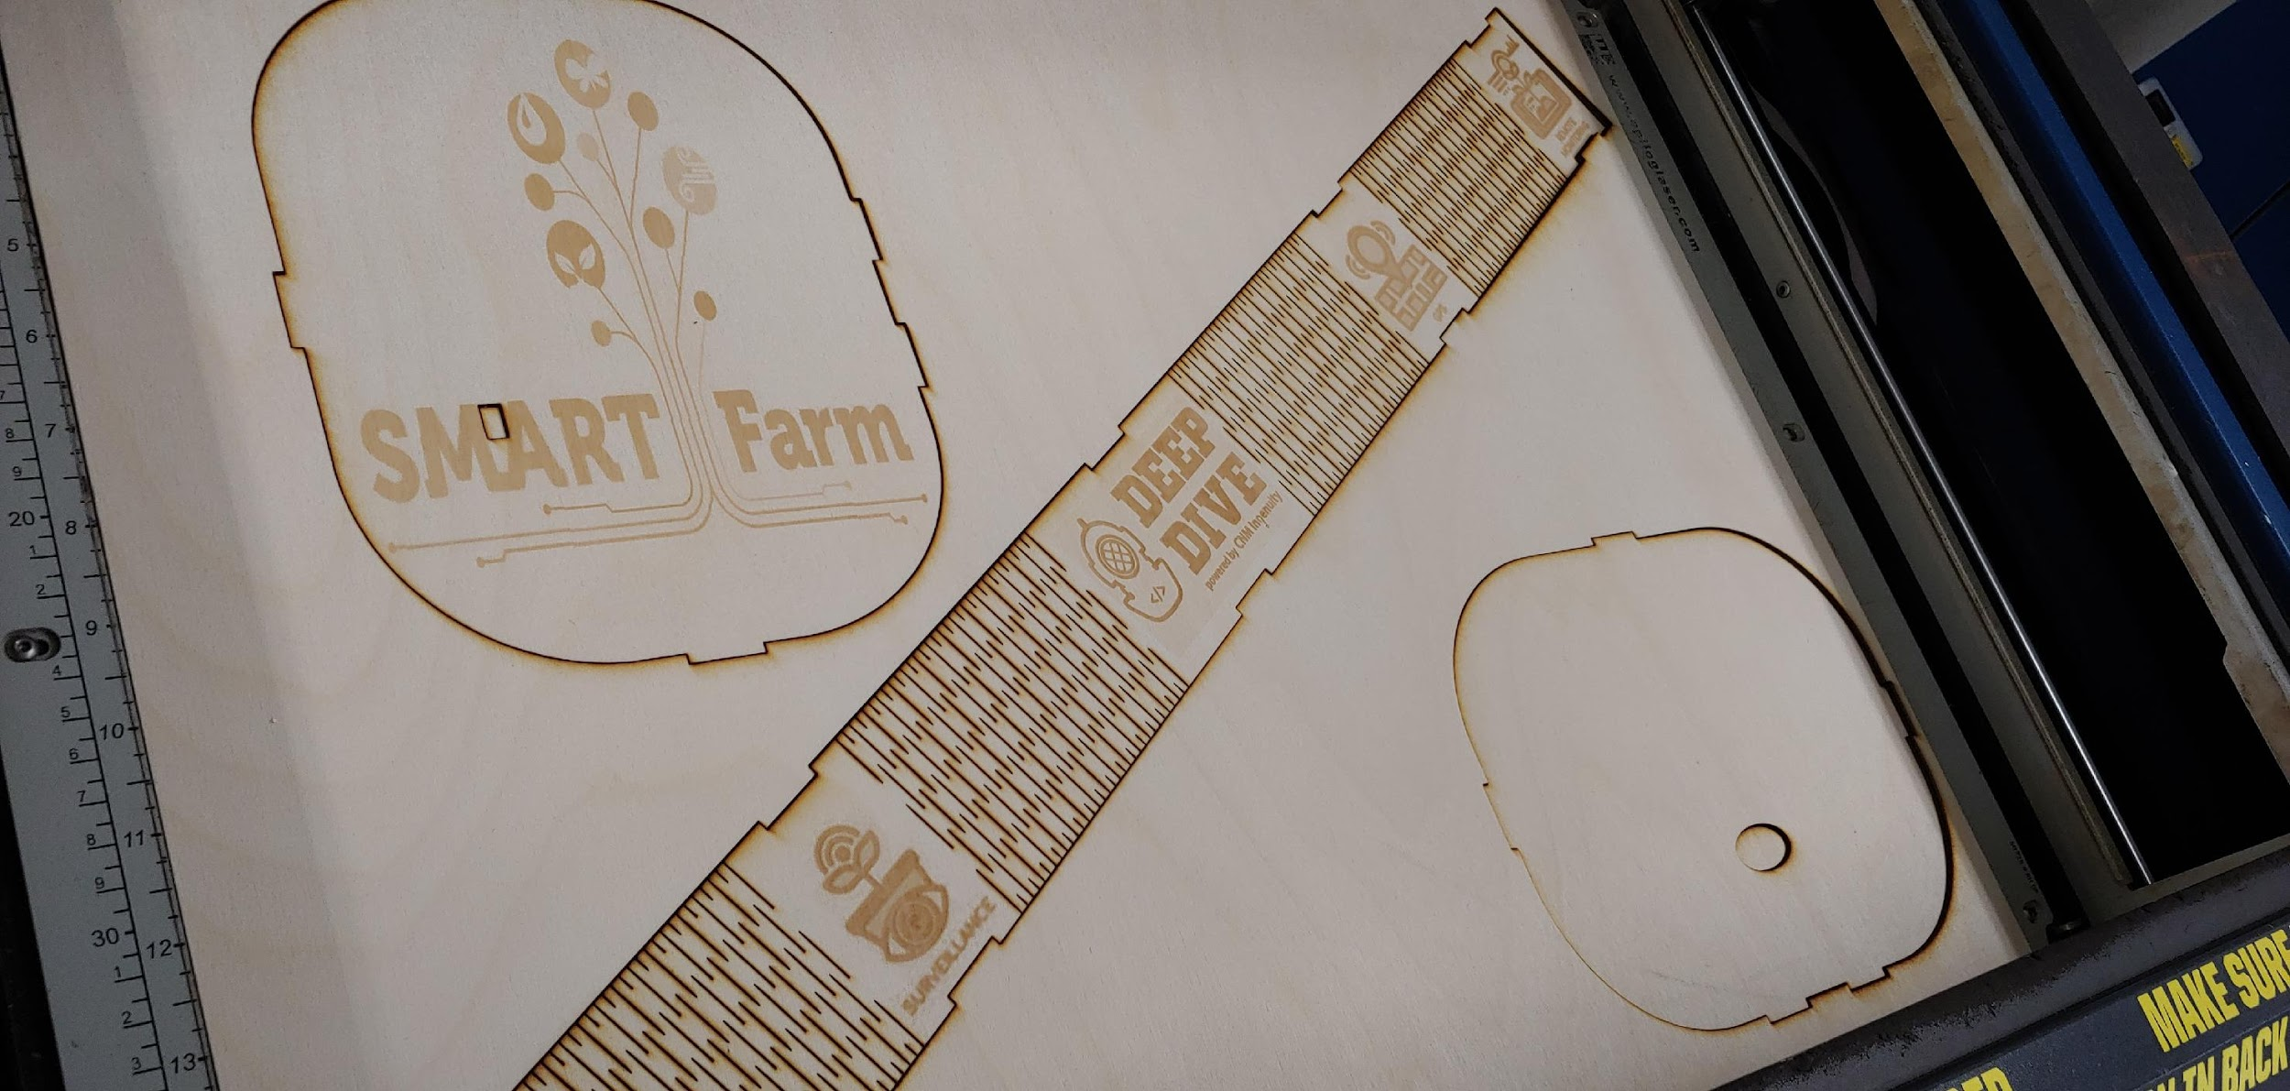
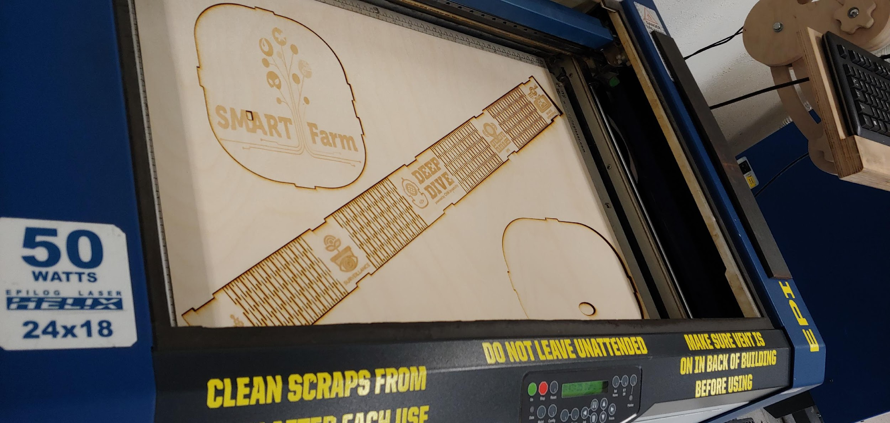
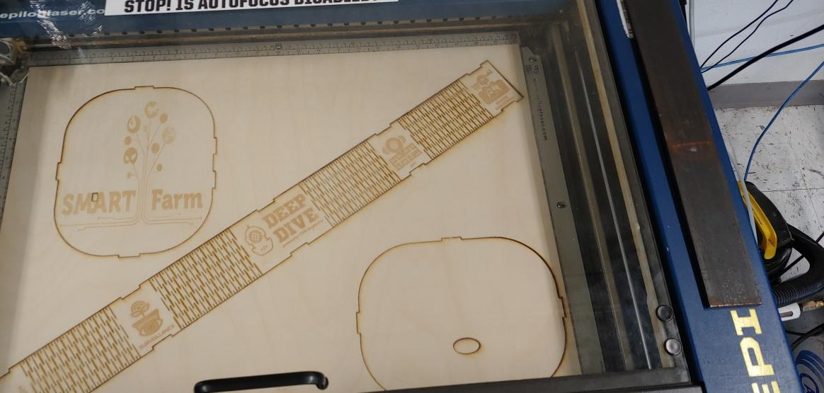
LASER CUT ENCLOSURE

Slide 17
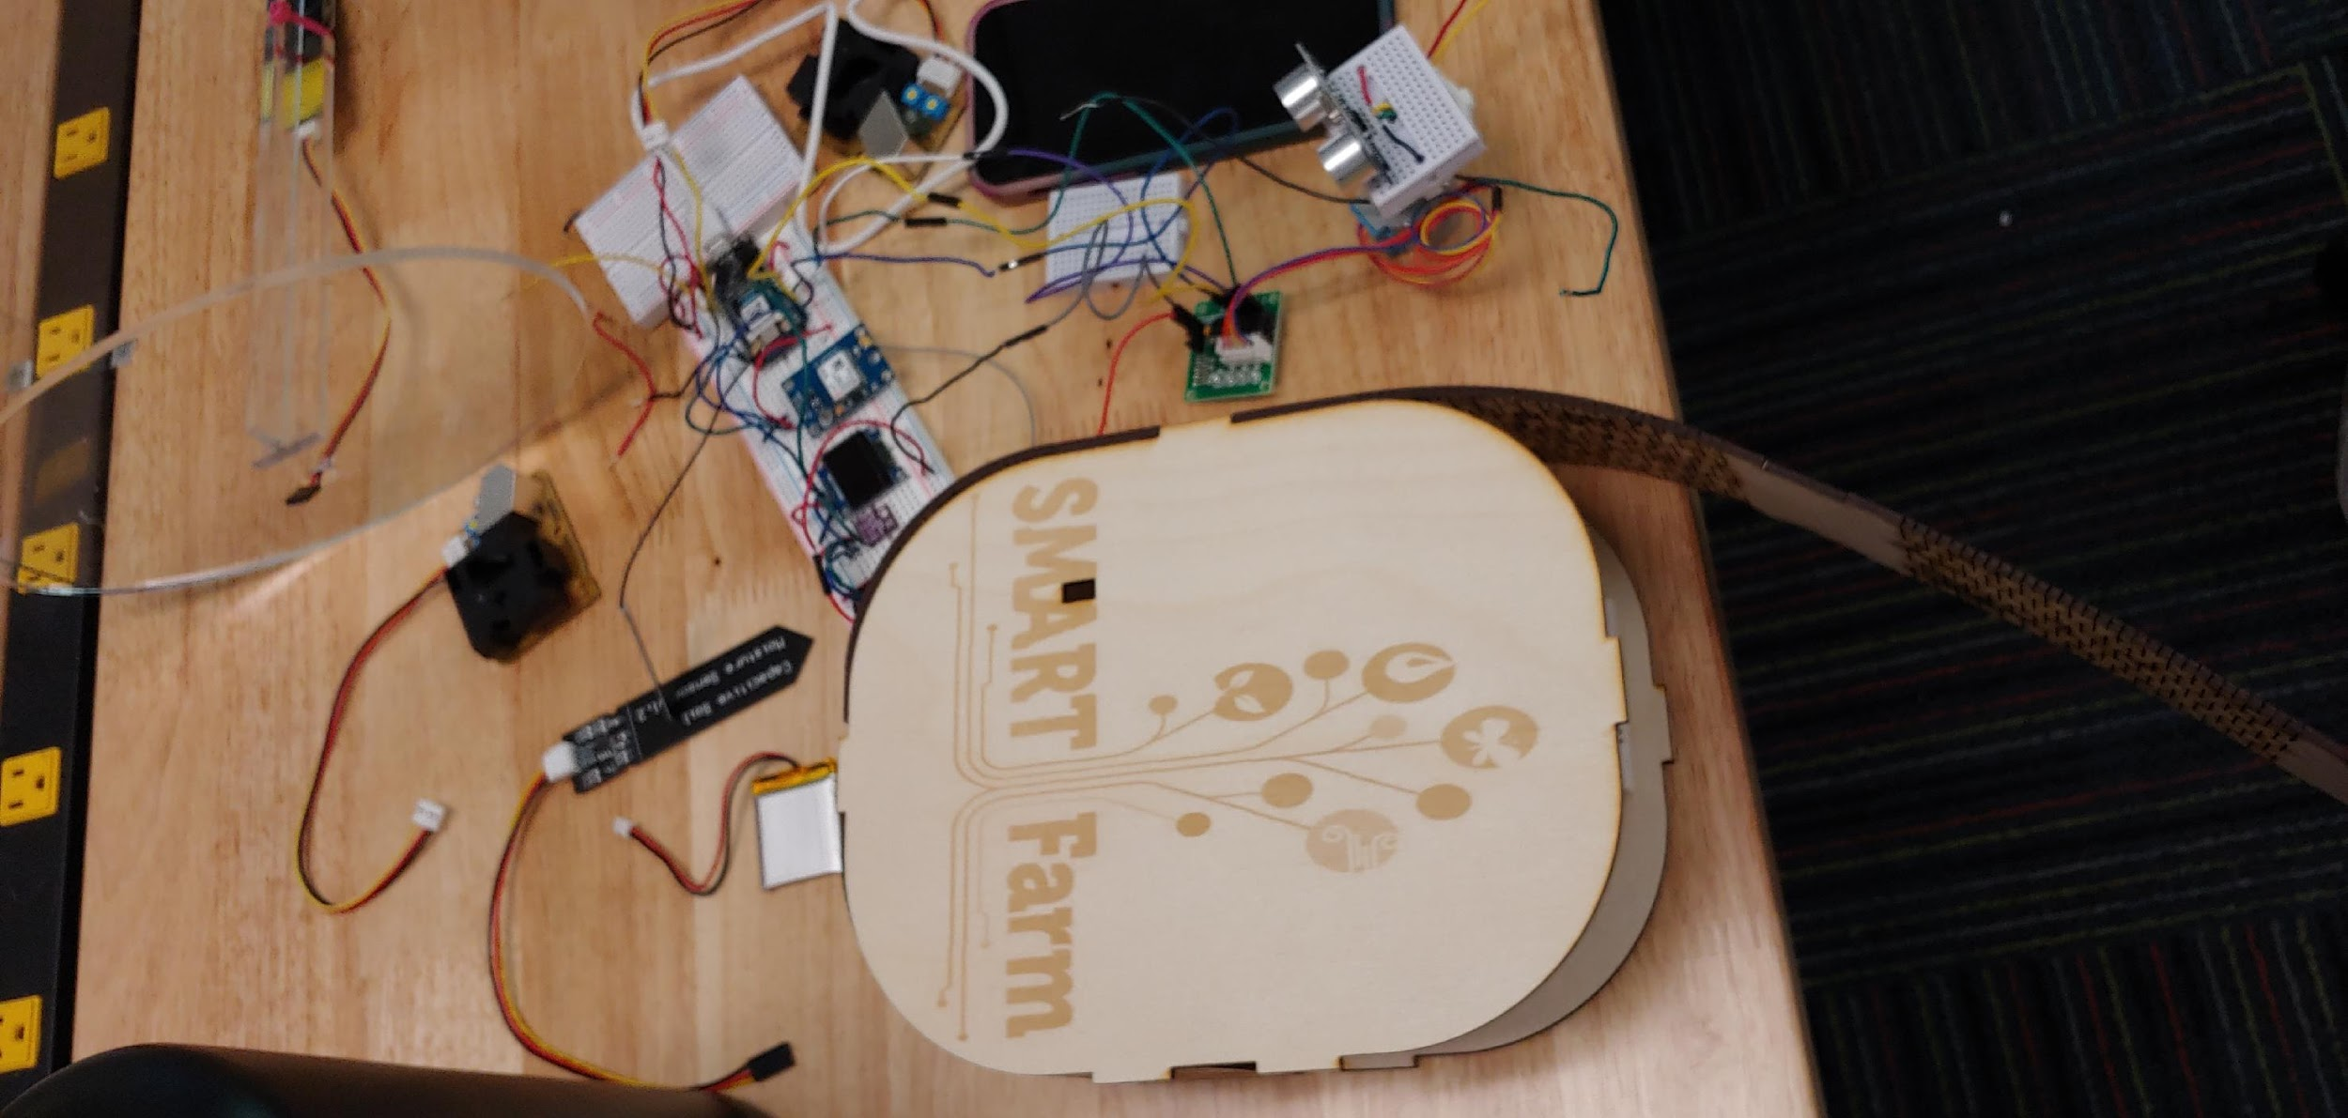
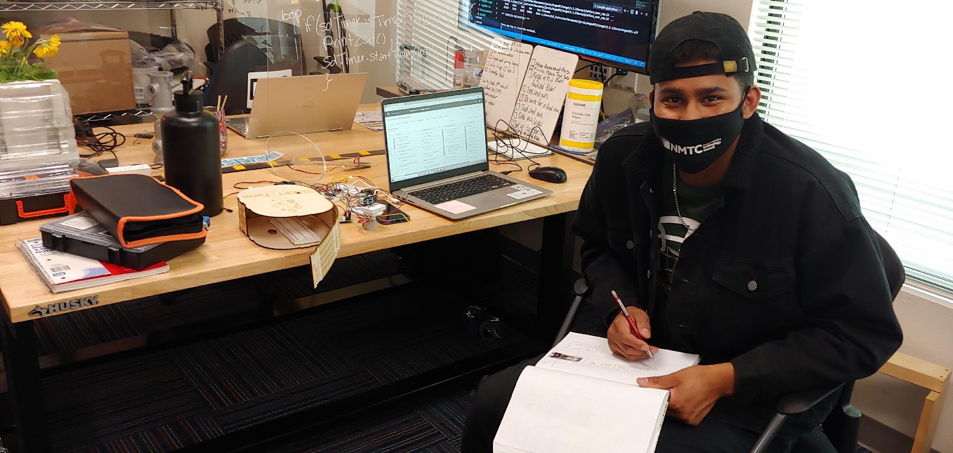
KAREEM HARD AT WORK

Slide 18
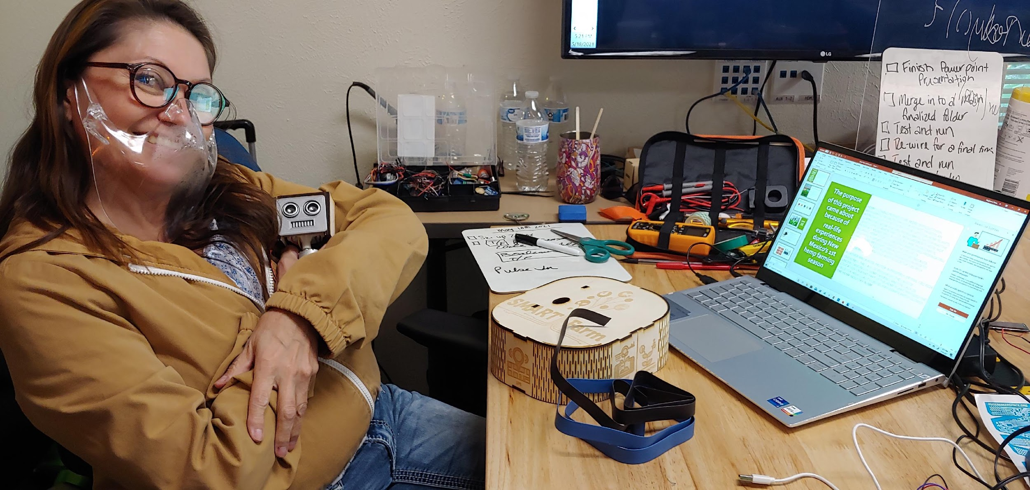

Slide 19
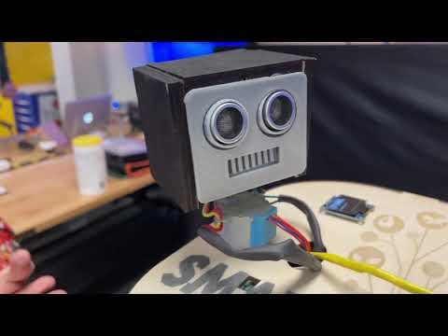
VIDEO DEMO
ASPECTS OF PRODUCT FUNCTIONALITY
DEMONSTRATION OF WORKING PROTOTYPE
FILM QUALITY HIGH
PHOTO QUALITY HIGH
ZOOM TO HIGHLIGHT COMPONENTS
NARRATION AND SUBTITLES USED TO EMPHASIZE POINTS

Slide 20


Developmental challenges
Problem solving
Teaming solutions

Slide 21
Future goals for project
Camera
Random Frequency output
2 Piezoelectric Elements
More efficient models
More efficient components
Geo mapping for rapid location of high pollen areas

Slide 22

Stephanie Perea sperea10@cnm.edu
Stephanie Perea | LinkedIn
Stephanie Perea - Hackster.io
Kareem Crum
Kareemcru@gmail.com
Kareem Crum | LinkedIn
Kareem Crum - Hackster.io

